Slide 1
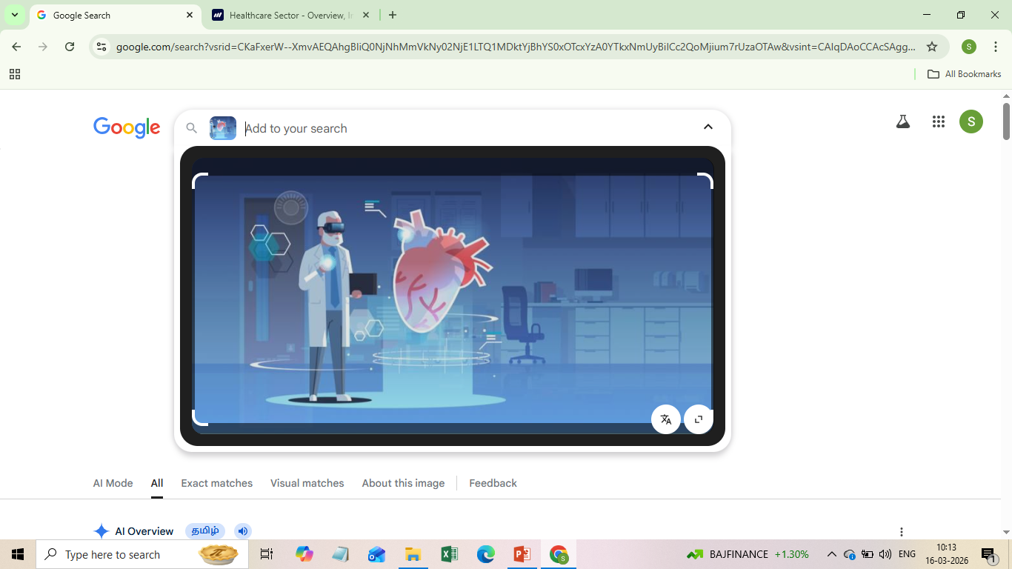
HEALTHCARE MANAGEMENT
By
SaraVANAPRIYA.D
DATA ANALYTICS

Slide 2
AIM:-
The main objective of this project is to analyze the given dataset, perform data cleaning using SQL, perform Derived metrics using SQL, to import into Power BI Desktop for making interactive dashboard, derive suitable DAX formulae.
It is also used to create meaningful clinical insights for better healthcare analysis.

Slide 3
INTRODUCTION:-
The dataset is taken from (MOCKAROO.COM/datasets).
Analyzing this dataset, we can understand the Total patient appointments, Hospital capacity, Doctors workload per patient, Insurance coverage and clinical insights which will be more helpful for better healthcare management.
Data visualizations are done using Power BI Desktop.

Slide 4
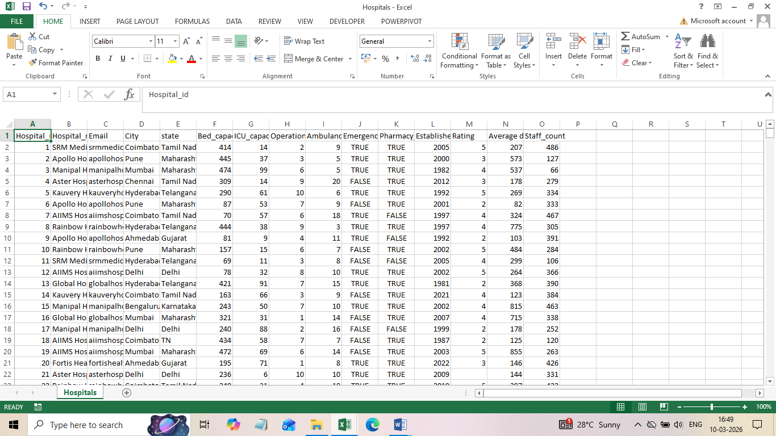
Dataset before cleaning:-

Slide 5
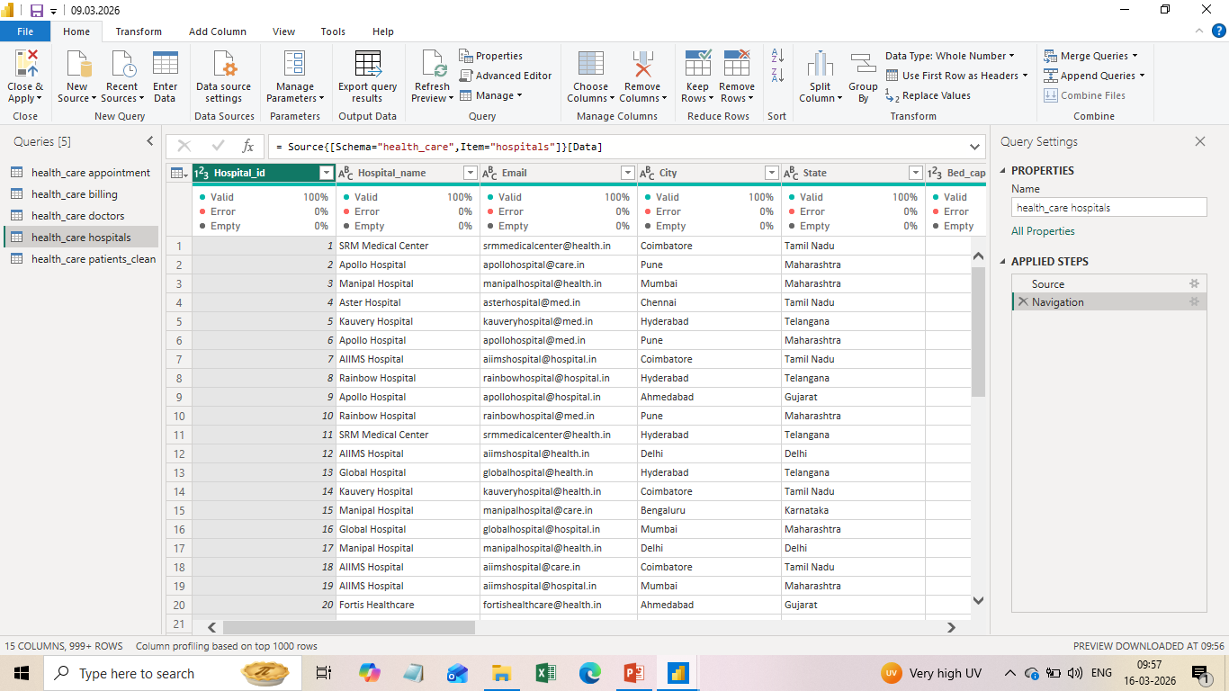
DATASET AFTER CLEANING:

Slide 6
DATASET CLEANING process:-
The raw data had been analyzed using excel and cleaned using SQL.
The dataset is about 1000 rows.
The process done in dataset are remove duplicates, handled null values and checked the consistency of the data type.
Performed suitable metrics.
Finally, the dataset is kept ready for importing into power BI desktop.
The Dashboard has been done in Power BI desktop.

Slide 7
SQL DATA TRANSFORMATION:
Updated inconsistent gender values for standardization.
Used CASE statements to standardize city and state names.
Identified duplicate records using GROUP BY and HAVING.
Removed duplicates using DISTINCT queries.

Slide 8
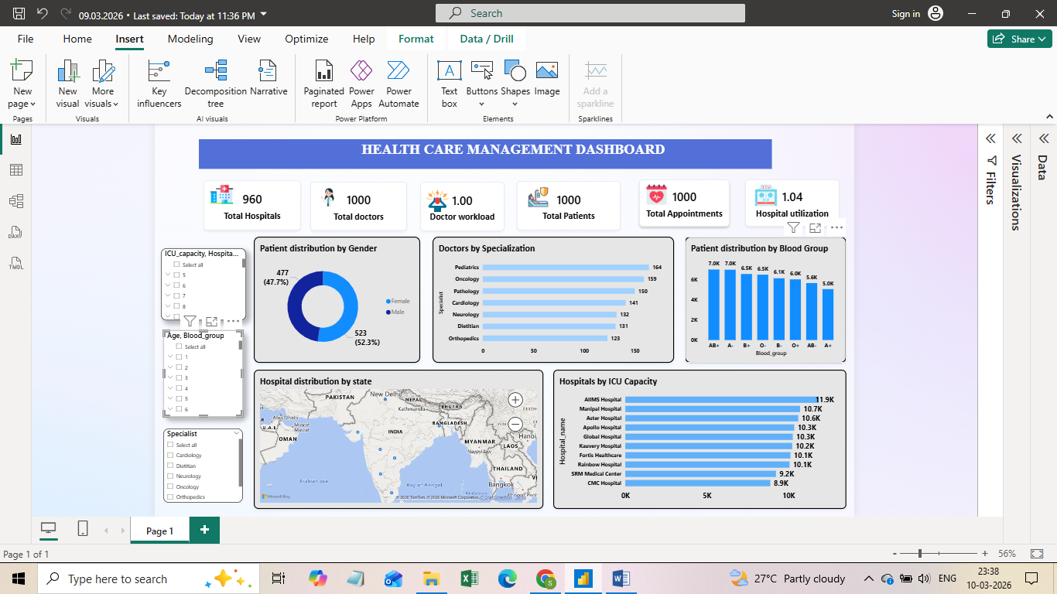
DASHBOARD:

Slide 9
CLINICAL INSIGHTS:-
Female patient proportion is slightly higher than male patients.
Certain blood groups appear more frequently among patients.
Doctor distribution across specializations is uneven.
Hospital utilization indicates high patient demand.

Slide 10
ACTION CAN BE TAKEN:
Expand women-focused healthcare services.
Maintain strong blood bank inventory for emergency care.
Balance doctor workload across departments.
Increase hospital bed capacity and ICU infrastructure.

Slide 11
CONCLUSION:
Finally, this project provides valuable insights into patient demographics, hospital capacity and doctor specialization.
By using interactive visualizations, decision-makers can improve resource allocation and optimize healthcare services.
Overall, this project demonstrates how data analytics support better clinical insights.

Slide 12
THANK YOU

